Slide 1

“Money-Transfer”
Task - 3

Slide 2


Money Transfer
The development of this project centered on the development of a message protocol that would allow the application to properly log in users, send messages, and perform system maintenance.
LMS USERNAME | NAME | BATCH
2115a439 | M.Pragthiyumnan | A4
2115a416 | M.HariHaran | A4
2115a415 | K.GokulRaj | A4
2115a429 | S.KavinKumar | A4

Slide 3
Task - 3
Create UI and implement various components using react
Split design into components and Higher order Components
Define structure of the components
Set the basic ui components with dummy data
Integrate the APIs to frontend to ensure the dynamic feature of website
Point base api to the severs base url
Design api calls for each element
Handle errors in the output
Render output of apis to different low level components
Secure content of post apisx
Evaluation Metric:
100% Completion of the above tasks
Learning Outcome
Developing complicated UI using react components
Using props drilling and context to pass variables
Getting familiar with different type of api calls
Handling different input data

Slide 4
Step-Wise Description
Step 1: Create app.js
Step 2: Breaking the UI into components ,Setting up the codebase.
Step 3: Creating the root component.
Step 4: For styling our login page we use app.css
Step 4: Create dummy username and password
Step 5: Validate the username and password enter by the user.
Step 6: Display an error message when the login fails .
Step 7: Show a success message when login is sucessful.
Summary of your task
To develop a money transfer web application. We use vs code text editor. Validate the username and password enter by the user.Tranfer Money from one account to another account . Display an error message when the login fails . Show a success message when login is sucessful.

Slide 5
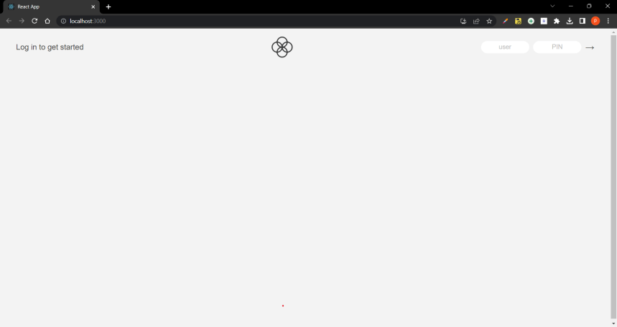
Login Page :

Slide 6
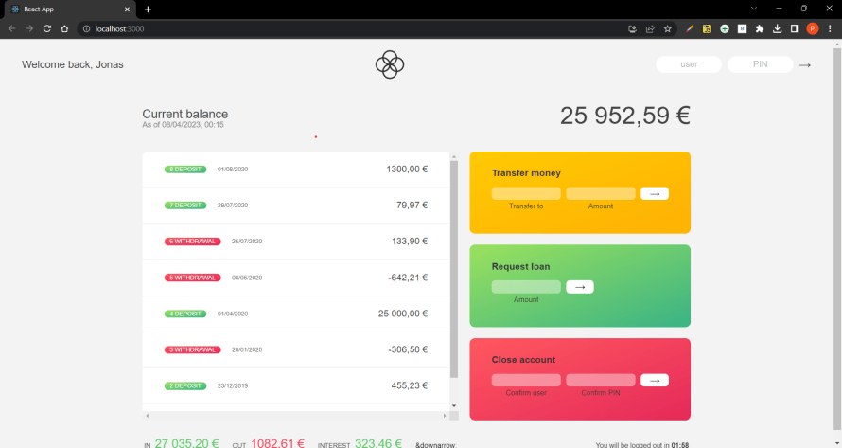
Home Page :

Slide 7
Submission Github
https://github.com/kavinkumar0/Moneytransfer

